Slide 1
Fare Prediction for New York taxi
Guided BY:
Professor Jongwook Woo
Team Member:
Adnan Elahi
Jinhui Liu
Shilpa konde Deshmukh
Siying Chen

Slide 2
Structure
Introduction
Objective
AzureML Model
Spark ML Model
Result Comparison- Azure ML Vs Spark ML
Summary
Limitations

Slide 3
Introduction
Fare prediction through Azure ML Model, Databricks and Spark ML Model
Key feature under consider to establish the dataset
Travel time
distance
passengers number

Slide 4
Dataset
As this is Dataset URL :-
https://www.kaggle.com/microize/newyork-yellow-taxi-trip-data-2020-2019
https://chriswhong.com/open-data/foil_nyc_taxi/
Number of Files : 6
File Format : csv (Comma-separated Values)

Slide 5
Dataset Details
 | KTSample | KaggleTaxi | fareSample | fare | tripSample | trip
FileSize | 10MB | 2.26GB | 9.99MB | 1.56GB | 9.92MB | 2.29GB
NumRow | 113,400 | 26,478,791 | 92,530 | 14,776,616 | 62,700 | 14,776,616
NumCol | 18 | 18 | 11 | 11 | 14 | 14

Slide 6
Hardware/Software Specification
Azure ML Studio(classic): 10GB storage, Single Node
Databricks Community Edition: 1 Driver, 15.3GB Memory, 2Cores, 1DBU with Runtime:8.1(Scala 2.12, Spark 3.1.1)
Spark: 2.3.2.3.1.4.0-315 version (Scala version 2.11.12, OpenJDK 64-bit Server VM)

Slide 7
Objective
By using Boosted Decision Tree Regression, Decision Forest Regression and Linear Regression to predict the fare amount by NYC taxi through Azure ML Model and Spark ML Model according to the dataset we collected and provided by professor.
In addition, we want to compare the data between Azure ML Model and Spark ML Model to see which one provider a better result in this scenario.

Slide 8


Slide 9





Flowchart
Gathering Data
Data Preprocessing
Data Split
Train and Test
Evaluate

Slide 10
AzureML Model
Decision Forest Regression
Boost Decision Tree Regression
Linear Regression

Slide 11
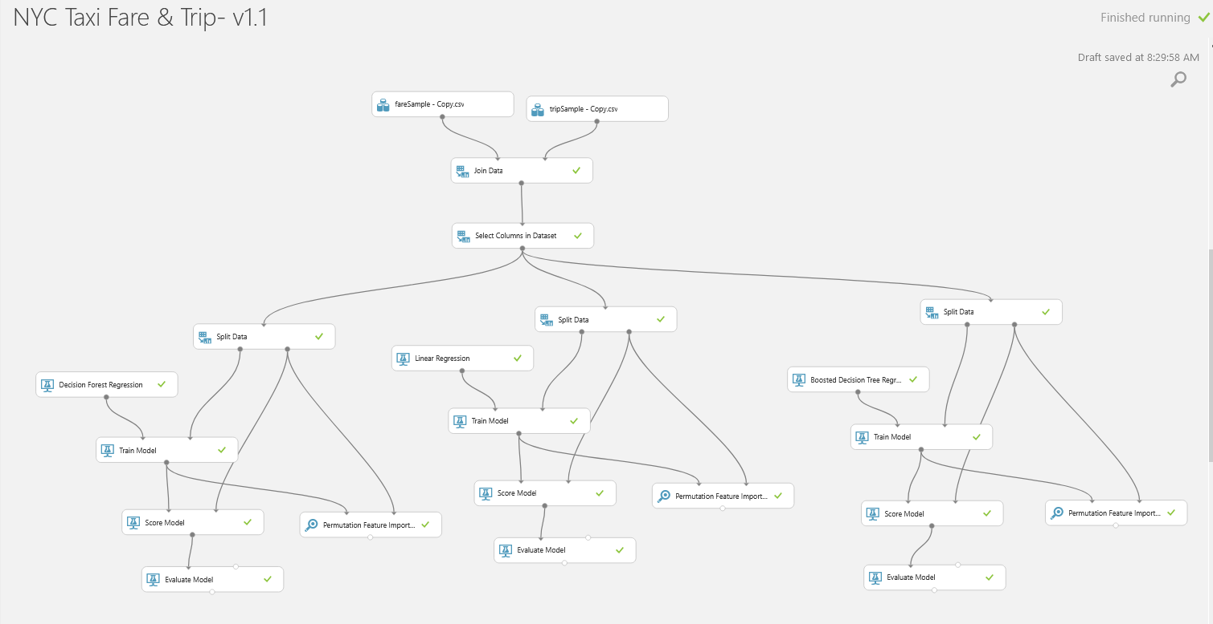

Slide 12
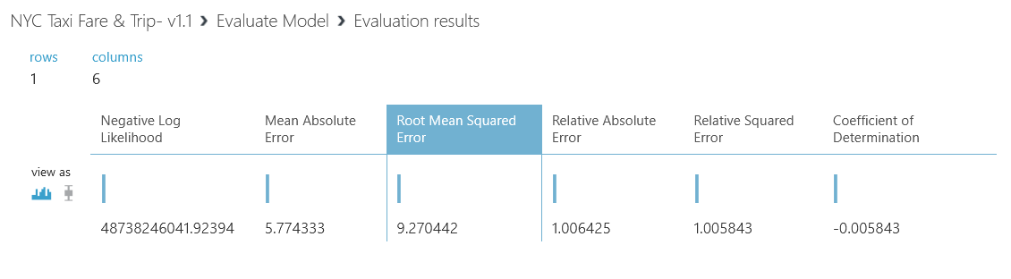
Decision Forest Regression -RMSE

Slide 13
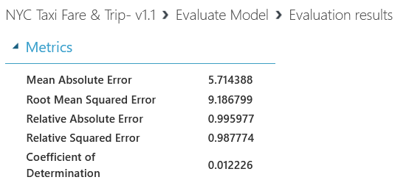
Linear Regression- RMSE

Slide 14
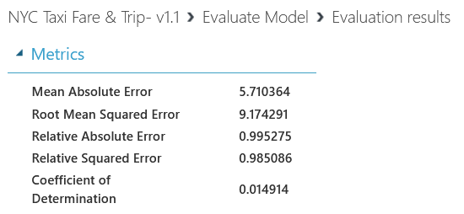
Boost Decision Tree Regression -RMSE

Slide 15
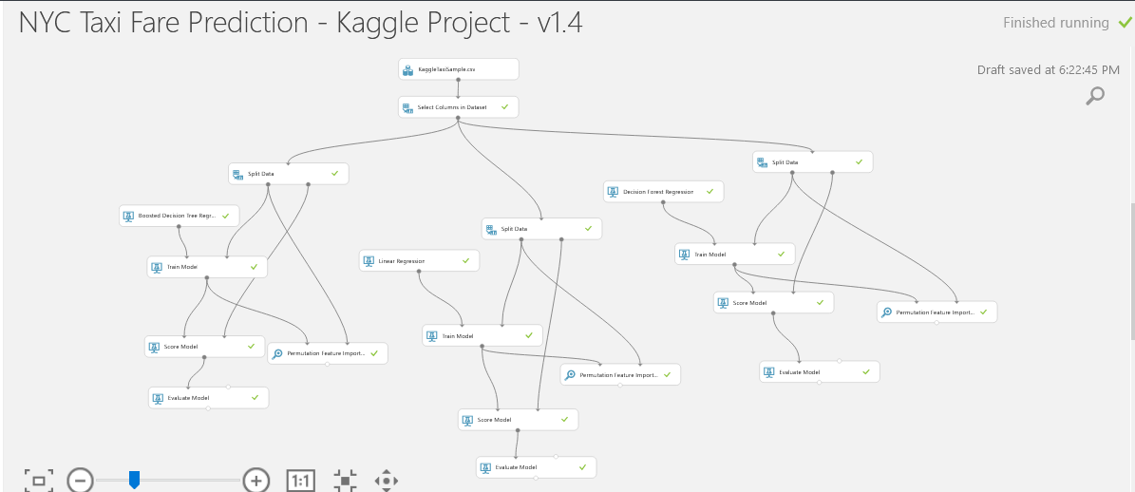

Slide 16
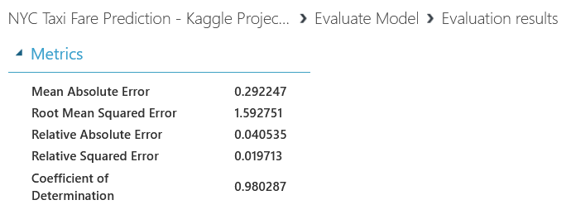
Boosted Tree Regression Model - RMSE

Slide 17
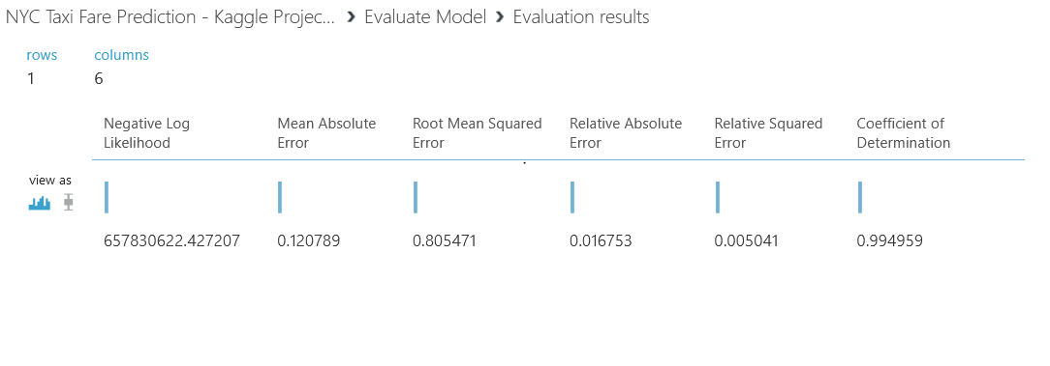
Decision Forest Regression- RMSE

Slide 18
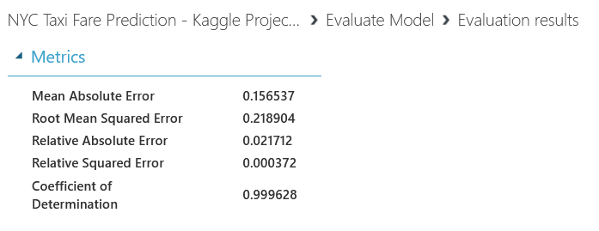
Linear Regression- RMSE

Slide 19
Databricks & Spark

Slide 20
Implementation
Load/Select/Filter Data
Split Data
Algorithm/
Cross Validator
Evaluator
Train/Fit
Transform/Test

Slide 21
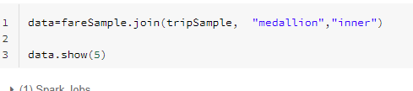
Data Preparation
For Fare.csv & Trip.csv
from Fare.csv

Slide 22
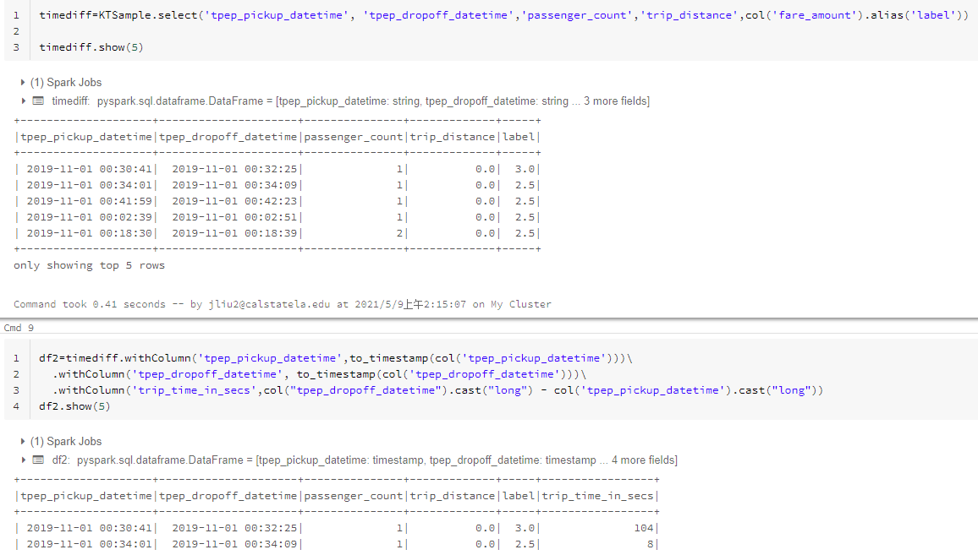
For KaggleTaxi.csv

Slide 23
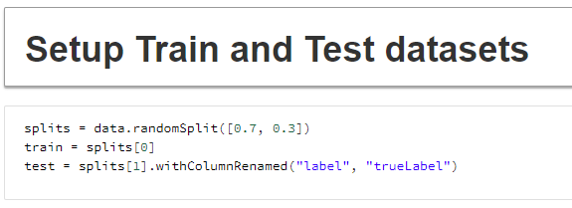
Train and Test Datasets Setting for Databricks and Spark

Slide 24
Databricks
Algorithm Used:
Gradient-Boosted Trees(GBT) Regression
Linear Regression
Decision Forest Regression
Datasets Used:
KTSample.csv - 10MB
fareSample.csv & tripSample.csv - 9.99MB+9.92MB

Slide 25
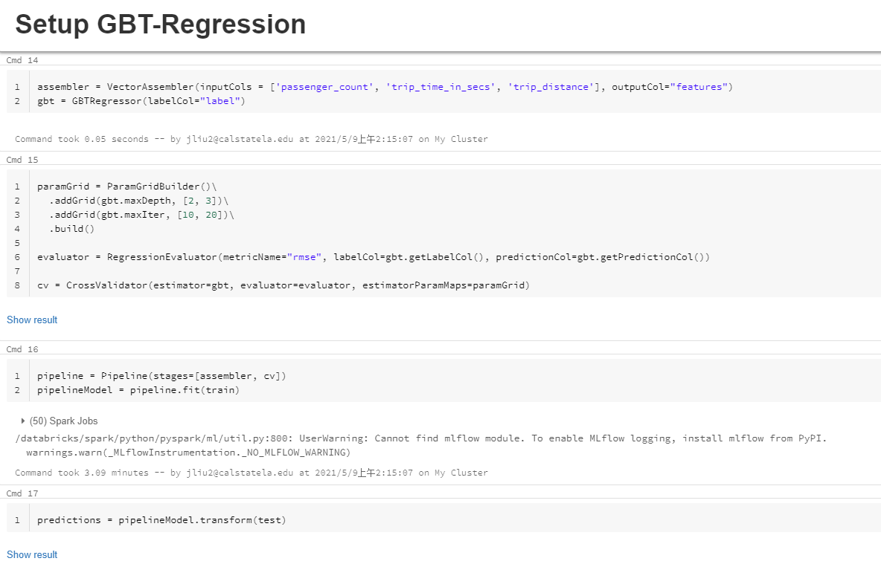
10
100

Slide 26
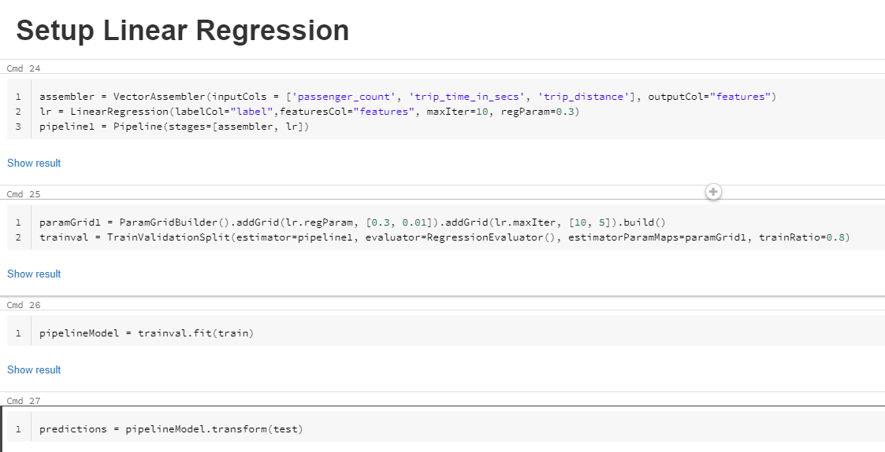

Slide 27
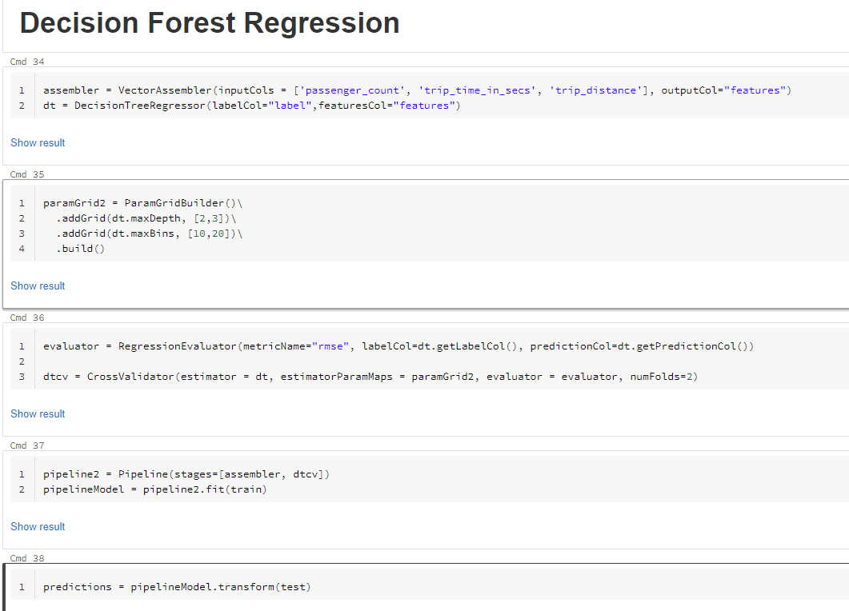
d=3

Slide 28
Sample Root Mean Square Error(RMSE) for Databricks
 | GBT | Linear | Decision Forest
KaggleTaxi(sample) | 5.333566329311697 | 5.747904934873378 | 5.99980552230505
FareTrip(sample) | 9.098194939712792 | 9.101831968270446 | 9.102872234972422

Slide 29
Spark
Algorithm Used:
Gradient-Boosted Trees(GBT) Regression
Linear Regression
Decision Forest Regression
Datasets Used:
KaggleTaxi.csv - 2.26GB
fareSample.csv & tripSample.csv - 9.99MB+9.92MB
fare.csv & trip.csv - 1.56GB+2.29GB

Slide 30
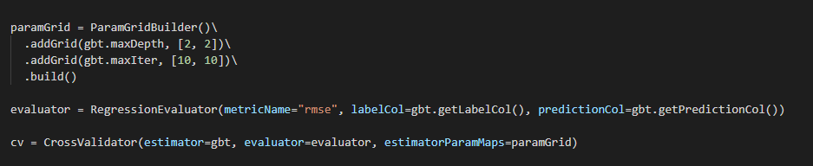

GBT Regression Setup and RMSE
(top for Kaggle, bottom for FareTripSample)

Slide 31
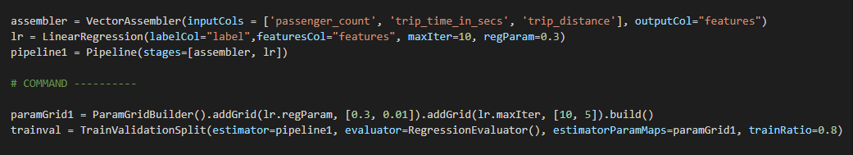
Linear Regression Setup and RMSE
(top for Kaggle, bottom for FareTripSample)

Slide 32
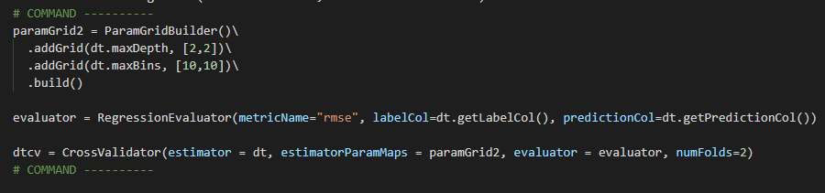
Decision Forest Regression Setup and RMSE
(top for Kaggle, bottom for FareTripSample)

Slide 33
Result/RMSE for Spark
 | GBT | Linear | Decision Forest
KaggleTaxi | 6.761245529158334 | 19.440409289556148 | 7.612226252624283
FareTrip(sample) | 9.291747402159348 | 9.296249657687463 | 9.323121583454949

Slide 34
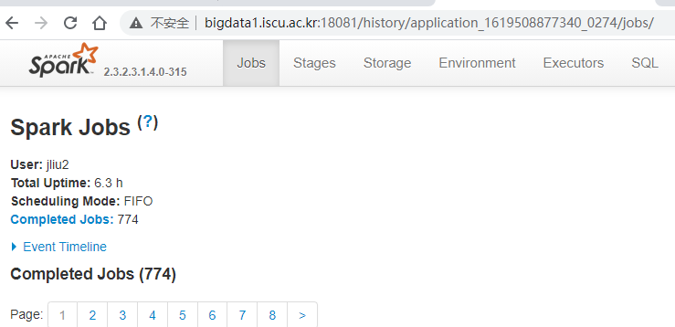
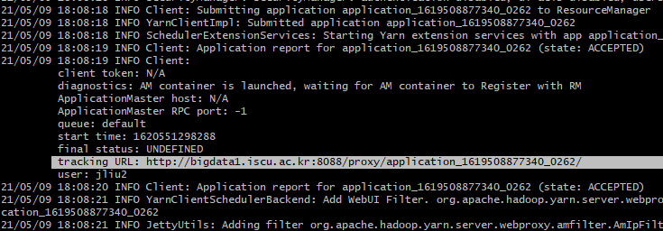
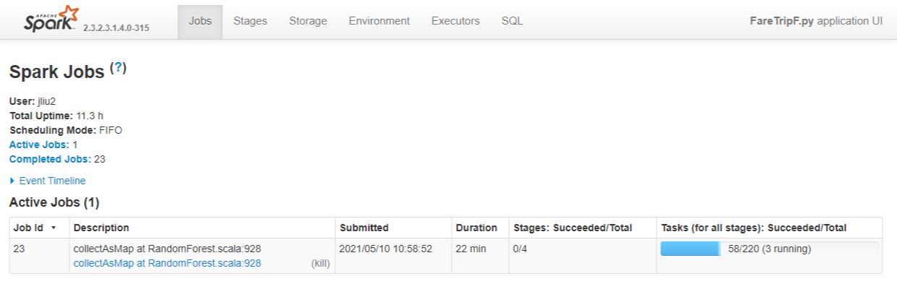
Tracking

Slide 35
Result Comparison(RMSE) : AzureML
 | Azure ML
 | Decision Forest Regression | Boost Decision Tree Regression | Linear Regression
KTSample | 0.958866 | 1.554201 | 0.812607
FareSample & TripSample | 9.270442 | 9.174291 | 9.186799
Notes:
We have used a few regression and classification models for predicting the lables and checking its accuracy for better performance.
we have 3 numbers from kaggle and faresample, liner regression has lowest number
boost desi

Slide 36
Result Comparison(RMSE) : Databricks
 | Databricks
 | Gradient Boosted Tree Regression | Linear Regression | Decision Forest Regression
KTSample | 5.333566329311697 | 5.747904934873378 | 5.99980552230505
FareSampleTripSample | 9.098194939712792 | 9.101831968270446 | 9.102872234972422

Slide 37
Result Comparison(RMSE) : Spark ML
 | Spark
 | Gradient Boosted Tree Regression | Linear Regression | Decision Forest Regression
KTSample | 6.761245529158334 | 19.440409289556148 | 7.612226252624283
FareSample & TripSample | 9.291747402159348 | 9.296249657687463 | 9.323121583454949

Slide 38
Summary
Based on selected features predictive analytics was conducted to predict the fare of New York taxi.
models between AzureML, databricks and SparkML ,linear regression model of azur for kaggal taxi data gave best result, and Gradient Boosted Tree Regression of data bricks for fare and trip sample data

Slide 39
Limitations
Feature prediction was much easier in AzureML than that of SparkML and Databricks.
Boosted dicison tree taking much time to run.

Slide 40
GitHub
https://github.com/liujh215/CIS5560.git

Slide 41
References
https://azure.microsoft.com/en-us/pricing/details/machine-learning-studio/
https://docs.azuredatabricks.net/_static/notebooks/gbt-regression.html
https://docs.rapidminer.com/latest/studio/operators/modeling/predictive/trees/gradient_boosted_trees.html
https://gist.github.com/colbyford/daa4508f6d8d94a405e7bd3a50c5ed77
https://spark.apache.org/docs/2.1.1/api/R/spark.gbt.html
https://spark.apache.org/docs/latest/api/python/reference/api/pyspark.sql.DataFrame.dropna.html
https://spark.apache.org/docs/latest/mllib-decision-tree.html
https://sparkbyexamples.com/spark/spark-difference-between-two-timestamps-in-seconds-minutes-and-hours/
https://www.w3schools.com/sql/sql_select.asp

Slide 42
Q & A

Slide 43
Thank you!

